Slide 1

Dynamic Programming
Dynamic Programming
Notes:
Merge Sort

Slide 2
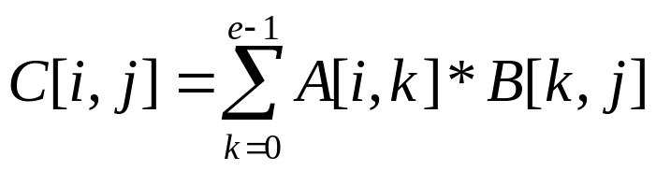

Matrix Chain-Products
Dynamic Programming is a general algorithm design paradigm.
  Rather than give the general structure, let us first give a motivating example:
  Matrix Chain-Products
Review: Matrix Multiplication.
  C = A*B
  A is d × e and B is e × f
  O(def ) time
f
B
j
e
e
A
C
d
i
i,j
d
Dynamic Programming
f

Slide 3
Matrix Chain-Products
Matrix Chain-Product:
  Compute A=A₀*A₁*…*A_{n-1}
  A_{i} is d_{i} × d_{i+1}
  Problem: How to parenthesize?
Example
  B is 3 × 100
  C is 100 × 5
  D is 5 × 5
  (B*C)*D takes 1500 + 75 = 1575 ops
  B*(C*D) takes 1500 + 2500 = 4000 ops
Dynamic Programming

Slide 4

An Enumeration Approach
Matrix Chain-Product Alg.:
  Try all possible ways to parenthesize A=A₀*A₁*…*A_{n-1}
  Calculate number of ops for each one
  Pick the one that is best
Running time:
  The number of paranethesizations is equal to the number of binary trees with n nodes
  This is exponential!
  It is called the Catalan number, and it is almost 4^{n}.
  This is a terrible algorithm!
Dynamic Programming

Slide 5

A Greedy Approach
Idea #1: repeatedly select the product that uses (up) the most operations.
Counter-example:
  A is 10 × 5
  B is 5 × 10
  C is 10 × 5
  D is 5 × 10
  Greedy idea #1 gives (A*B)*(C*D), which takes 500+1000+500 = 2000 ops
  A*((B*C)*D) takes 500+250+250 = 1000 ops
Dynamic Programming

Slide 6
Another Greedy Approach
Idea #2: repeatedly select the product that uses the fewest operations.
Counter-example:
  A is 101 × 11
  B is 11 × 9
  C is 9 × 100
  D is 100 × 99
  Greedy idea #2 gives A*((B*C)*D)), which takes 109989+9900+108900=228789 ops
  (A*B)*(C*D) takes 9999+89991+89100=189090 ops
The greedy approach is not giving us the optimal value.
Dynamic Programming

Slide 7

A “Recursive” Approach
Define subproblems:
  Find the best parenthesization of A_{i}*A_{i+1}*…*A_{j}.
  Let N_{i,j} denote the number of operations done by this subproblem.
  The optimal solution for the whole problem is N_{0,n-1}.
Subproblem optimality: The optimal solution can be defined in terms of optimal subproblems
  There has to be a final multiplication (root of the expression tree) for the optimal solution.
  Say, the final multiply is at index i: (A₀*…*A_{i})*(A_{i+1}*…*A_{n-1}).
  Then the optimal solution N_{0,n-1} is the sum of two optimal subproblems, N_{0,i} and N_{i+1,n-1} plus the time for the last multiply.
  If the global optimum did not have these optimal subproblems, we could define an even better “optimal” solution.
Dynamic Programming

Slide 8

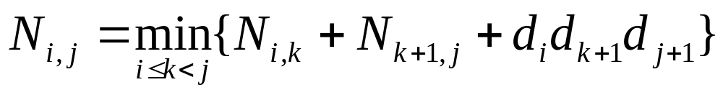
A Characterizing Equation
The global optimal has to be defined in terms of optimal subproblems, depending on where the final multiply is at.
Let us consider all possible places for that final multiply:
  Recall that A_{i} is a d_{i} × d_{i+1} dimensional matrix.
  So, a characterizing equation for N_{i,j} is the following:
Note that subproblems are not independent--the subproblems overlap.
Dynamic Programming

Slide 9

A Dynamic Programming Algorithm
Since subproblems overlap, we don’t use recursion.
Instead, we construct optimal subproblems “bottom-up.”
N_{i,i}’s are easy, so start with them
Then do length 2,3,… subproblems, and so on.
The running time is O(n³)
Algorithm matrixChain(S):
Input: sequence S of n matrices to be multiplied
Output: number of operations in an optimal paranethization of S
  for i ← 1 to n-1 do
  N_{i,i} ← 0
  for b ← 1 to n-1 do
  for i ← 0 to n-b-1 do
  j ← i+b
  N_{i,j} ← +infinity
  for k ← i to j-1 do
  N_{i,j} ← min{N_{i,j} , N_{i,k} +N_{k+1,j} +d_{i} d_{k+1} d_{j+1}}
Dynamic Programming

Slide 10
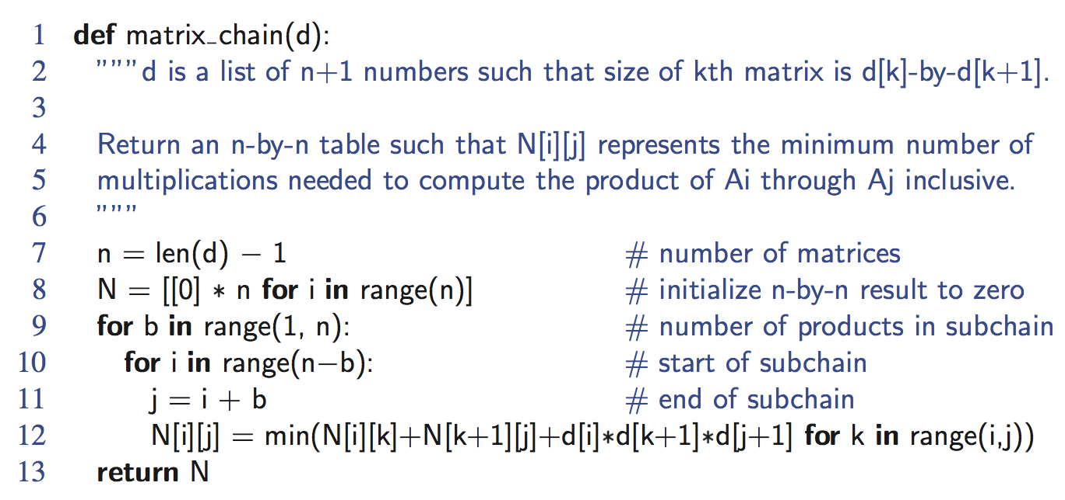
Python Implementation
Dynamic Programming

Slide 11
A Dynamic Programming Algorithm Visualization
The bottom-up construction fills in the N array by diagonals
N_{i,j} gets values from pervious entries in i-th row and j-th column
Filling in each entry in the N table takes O(n) time.
Total run time: O(n³)
Getting actual parenthesization can be done by remembering “k” for each N entry
answer
N
0
1
2
j
…
n-1
0
1
…
i
n-1
Dynamic Programming

Slide 12

The General Dynamic Programming Technique
Applies to a problem that at first seems to require a lot of time (possibly exponential), provided we have:
  Simple subproblems: the subproblems can be defined in terms of a few variables, such as j, k, l, m, and so on.
  Subproblem optimality: the global optimum value can be defined in terms of optimal subproblems
  Subproblem overlap: the subproblems are not independent, but instead they overlap (hence, should be constructed bottom-up).
Dynamic Programming

Slide 13
Subsequences
A subsequence of a character string x₀x₁x₂…x_{n-1} is a string of the form x_{i1}x_{i2}…x_{ik}, where ij < ij+1.
Not the same as substring!
Example String: ABCDEFGHIJK
  Subsequence: ACEGJIK
  Subsequence: DFGHK
  Not subsequence: DAGH
Dynamic Programming

Slide 14
The Longest Common Subsequence (LCS) Problem
Given two strings X and Y, the longest common subsequence (LCS) problem is to find a longest subsequence common to both X and Y
Has applications to DNA similarity testing (alphabet is {A,C,G,T})
Example: ABCDEFG and XZACKDFWGH have ACDFG as a longest common subsequence
Dynamic Programming

Slide 15
A Poor Approach to the LCS Problem
A Brute-force solution:
  Enumerate all subsequences of X
  Test which ones are also subsequences of Y
  Pick the longest one.
Analysis:
  If X is of length n, then it has 2^{n} subsequences
  This is an exponential-time algorithm!
Dynamic Programming

Slide 16
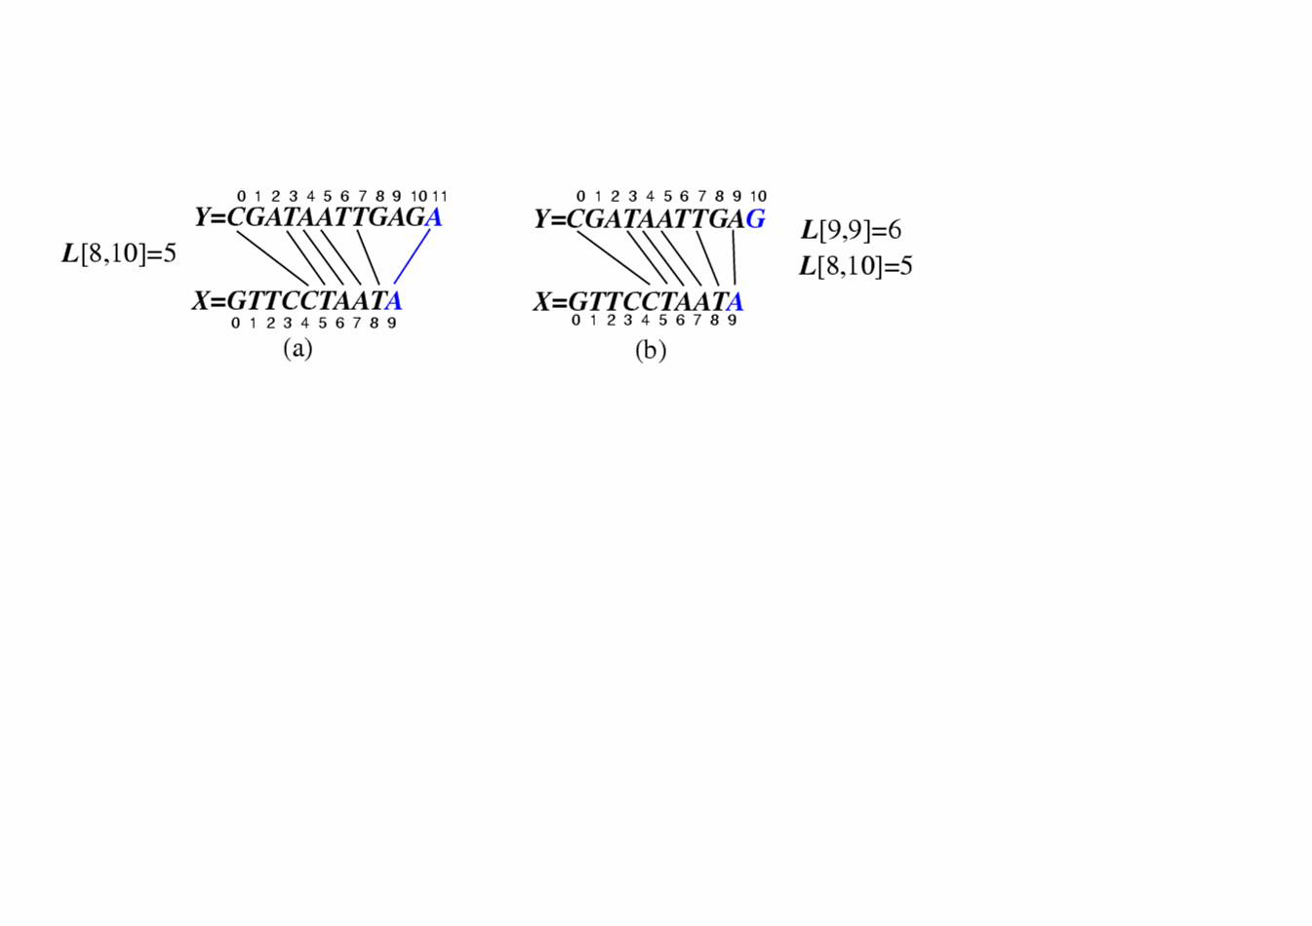
A Dynamic-Programming Approach to the LCS Problem
Define L[i,j] to be the length of the longest common subsequence of X[0..i] and Y[0..j].
Allow for -1 as an index, so L[-1,k] = 0 and L[k,-1]=0, to indicate that the null part of X or Y has no match with the other.
Then we can define L[i,j] in the general case as follows:
  If xi=yj, then L[i,j] = L[i-1,j-1] + 1 (we can add this match)
  If xi≠yj, then L[i,j] = max{L[i-1,j], L[i,j-1]} (we have no match here)
Case 1:
Case 2:
Dynamic Programming

Slide 17
An LCS Algorithm
Algorithm LCS(X,Y ):
Input: Strings X and Y with n and m elements, respectively
Output: For i = 0,…,n-1, j = 0,...,m-1, the length L[i, j] of a longest string that is a subsequence of both the string X[0..i] = x₀x₁x₂…x_{i} and the string Y [0.. j] = y₀y₁y₂…y_{j}
for i =1 to n-1 do
L[i,-1] = 0
for j =0 to m-1 do
L[-1,j] = 0
for i =0 to n-1 do
for j =0 to m-1 do
if x_{i} = y_{j} then
L[i, j] = L[i-1, j-1] + 1
else
L[i, j] = max{L[i-1, j] , L[i, j-1]}
return array L
Dynamic Programming

Slide 18
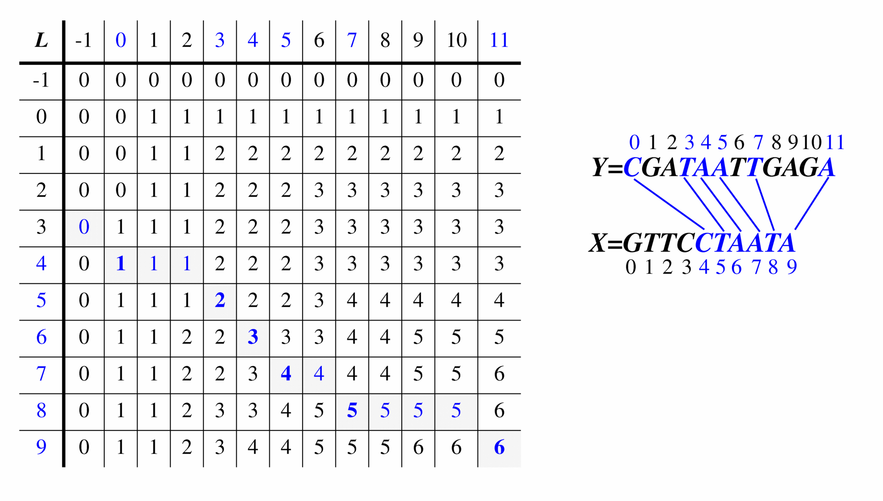
Visualizing the LCS Algorithm
Dynamic Programming

Slide 19
Analysis of LCS Algorithm
We have two nested loops
  The outer one iterates n times
  The inner one iterates m times
  A constant amount of work is done inside each iteration of the inner loop
  Thus, the total running time is O(nm)
Answer is contained in L[n,m] (and the subsequence can be recovered from the L table).
Dynamic Programming

Slide 20
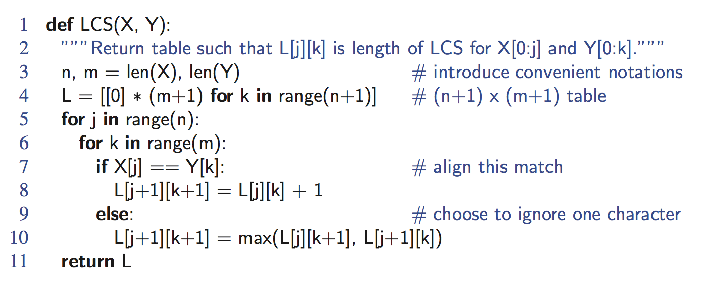
Python Implementation
Dynamic Programming

Slide 21
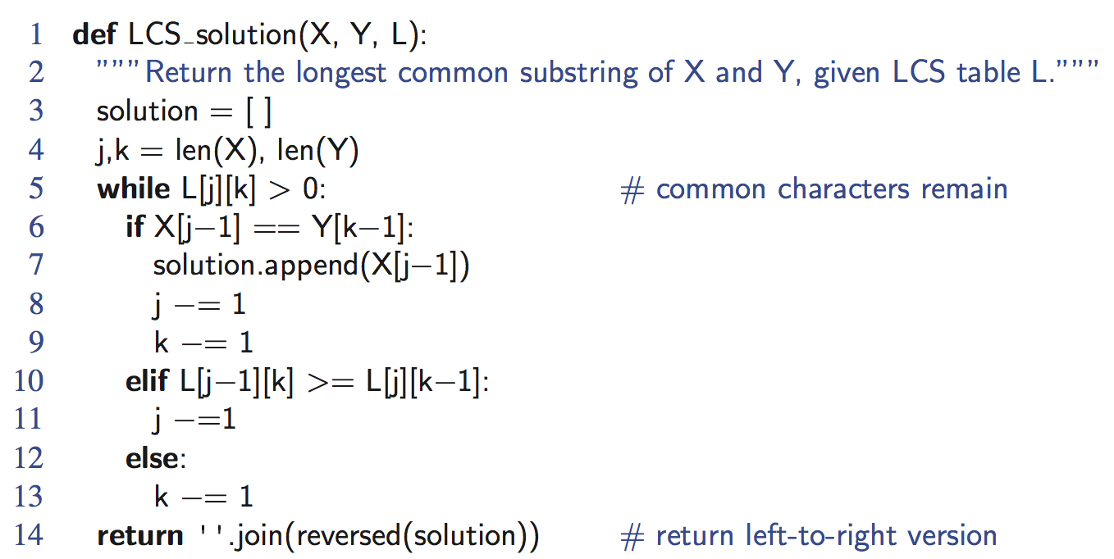
Python Implementation, Output of the Solution
Dynamic Programming

